Slide 1
Chapter Five
Local Area Networking Technology

Slide 2
Introduction
A local area network (LAN) is a data communication network that serves users in a confined geographic area and uses high transmission speeds (typically 10 mbps to few gbps)
Designed and developed for communications and resource sharing in a local work environment (room, campus, building).
A single shared medium, usually a cable, to which computers can attach.
Because sharing occurs:
Cost decreases
Computers have to coordinate the use of the network
LANs operate at the physical and data link layers

Slide 3
In OSI terms, higher layer protocols (layer 3 or 4 and above) are independent of network architecture and are applicable to LANs, MANs, and WANs
LAN protocols is concerned principally with lower layers (Layer 1 and 2) of the OSI model
IEEE 802 reference model

Slide 4
the lowest layer of the IEEE 802 reference model corresponds to the physical layer
Includes functions:
Encoding/decoding of signals
Preamble generation/removal (for synchronization)
Bit transmission/reception
Notes:
A preamble is a signal used in network communications to synchronize transmission timing between two or more systems.

Slide 5
The functions associated with providing service to LAN users include:
On transmission, assemble data into a frame with address and error-detection fields.
On reception, disassemble frame, perform address recognition and error detection.
Govern access to the LAN transmission medium.
Provide an interface to higher layers and perform flow and error control

Slide 6
Access Methods
broadcast channels are sometimes referred to as multi-access channels or random access channels.
The methods that can be used to determine how the shared media is accessed are called Access methods.
The protocols used to determine who goes next on a multi-access channel.
It belongs to the sub-layer of the data link layer called MAC (Medium Access Control) sub-layer
The MAC sub-layer is especially important in LANs,
many of LANs use a multi-access channel as the basis for communication.
WANs, in contrast, use point-to-point links, except for satellite networks

Slide 7
Pure ALOHA
The earliest of access methods
was developed for packet radio networks
is also applicable to any shared transmission medium
is a true free-for-all
The station waits for
an amount of time (The maximum round-trip propagation delay on the network)
twice the time it takes to send a frame between the two most widely separated stations
plus a small fixed time increment
If the station fails to receive an acknowledgment after repeated transmissions, it gives up.
Collision happens if two stations send frame at the same time.
As the number of collisions rises rapidly with increased load, the maximum utilization of the channel is only about 18%

Slide 8
Slotted ALOHA
time on the channel is organized into uniform slots whose size equals the frame transmission time.
Some central clock or other technique is needed to synchronize all stations.
Transmission is permitted to begin only at a slot boundary.
still collision is possible;
collided packets are retransmitted after a random delay

Slide 9
CSMA - Carrier Sense MA - polite version of ALOHA
to minimize the chance of collision, each station first listens to the medium before sending; “listen before talk”
if the channel is busy, it waits until it is idle. Otherwise it transmits.
if a collision occurs, it waits a random amount of time and starts listening again.
the chance of collision is minimized, but may still occur because of
the propagation delay (a station doesn’t know if another one has just started transmitting);
or if two or more stations start transmitting at the same time

Slide 10
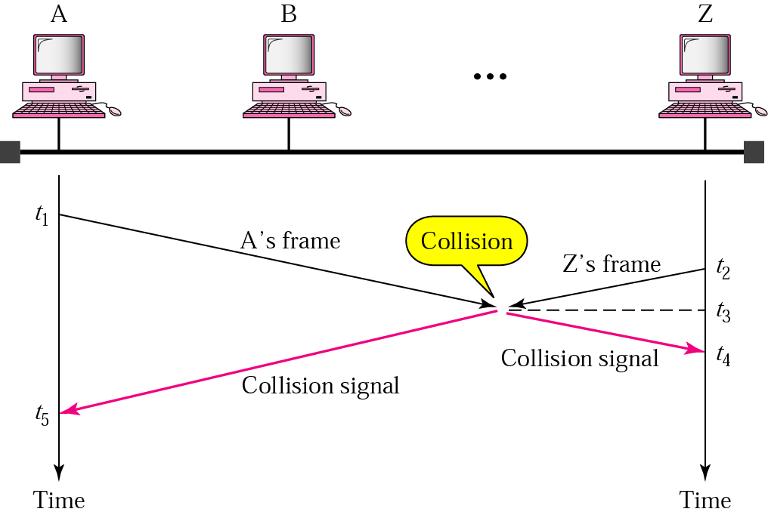
t₁ < t₂ < t₃ < t₄ < t₅

Slide 11
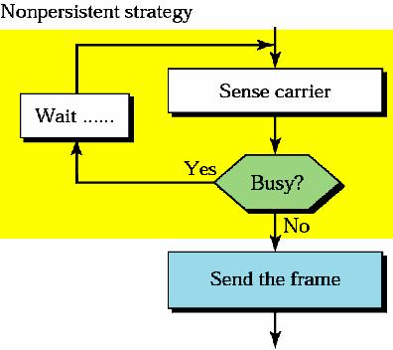
Two sub-strategies have been defined
Non-persistent: sense a line and send if it is idle;
otherwise wait a random amount of time (hence less greedy than continuously listening);
reduces the chance of collision, but also reduces the efficiency of the network and has longer delays

Slide 12
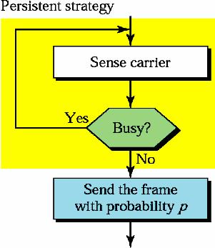
persistent: sense a line and “send” if it is idle; otherwise listen; two variations
1-persistent: if the line is idle, send immediately (with probability 1).
p-persistent: if the line is idle, send with probability p and refrain from sending with probability 1-p; if p = 0.2, then a station sends 20% of the time that a line is idle, and refrains from sending 80% of the time
it reduces the chance of collision and improves efficiency; depends on the value of p

Slide 13
CSMA/CD - CSMA with Collision Detection
adds a procedure to handle a collision
if a collision is detected and to reduce the probability of collision the second time, the sender waits; it has to back off
it waits a little the first time, more if a collision occurs again, much more if it happens a third time, and so on; finally gives up
in the exponential back off method, it waits an amount of time between 0 and 2^{N} X maximum_propagation_time,
where N is the number of attempted transmissions
line sensing is done using one of the persistent strategies

Slide 14
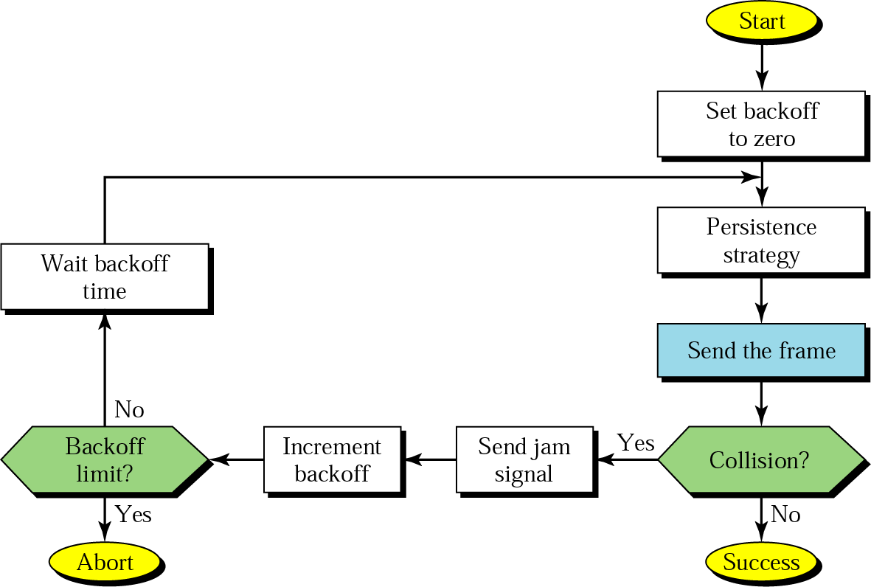
sending a jam alerts to the other stations and also to discard the part of the frame received
used in traditional Ethernet; CSMA was never implemented

Slide 15
CSMA/CA - CSMA with Collision Avoidance
avoids collision
uses one of the persistence strategies;
after it finds the line idle, it waits an IFG (interframe gap) amount of time;
it then waits another random amount of time;
after that it sends the frame and sets a timer;
if it receives an ack before the timer expires, the transmission is successful;
otherwise something is wrong (the frame or the ack is lost);
waits for a backoff amount of time and re-senses the line
used in wireless LANs

Slide 16
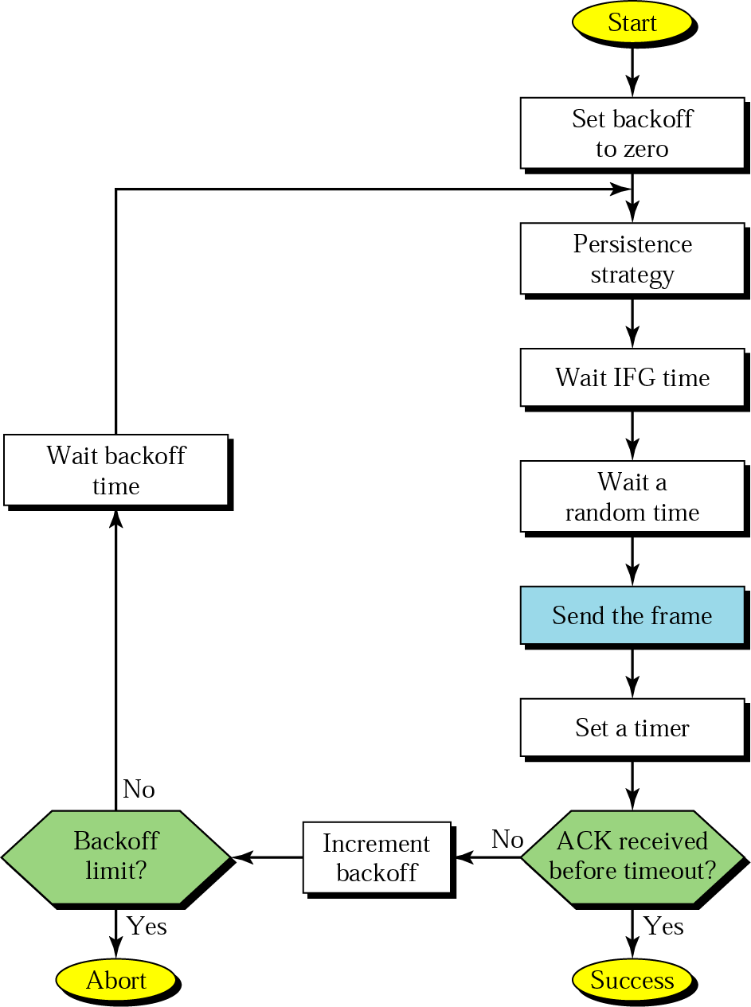
the frame or the ack is lost

Slide 17
Token Passing
a station is authorized to send data when it receives a special frame called a token.
the stations are arranged around a ring (each station has a predecessor and a successor)
a token circulates around the ring when no data is transmitted
token: a bit sequence
free token: 01111110
busy token: 01111111
when a node wants to transmit
wait for free token
remove token from ring (replace with busy token)
transmit message
when done transmitting, replace free token on ring

Slide 18
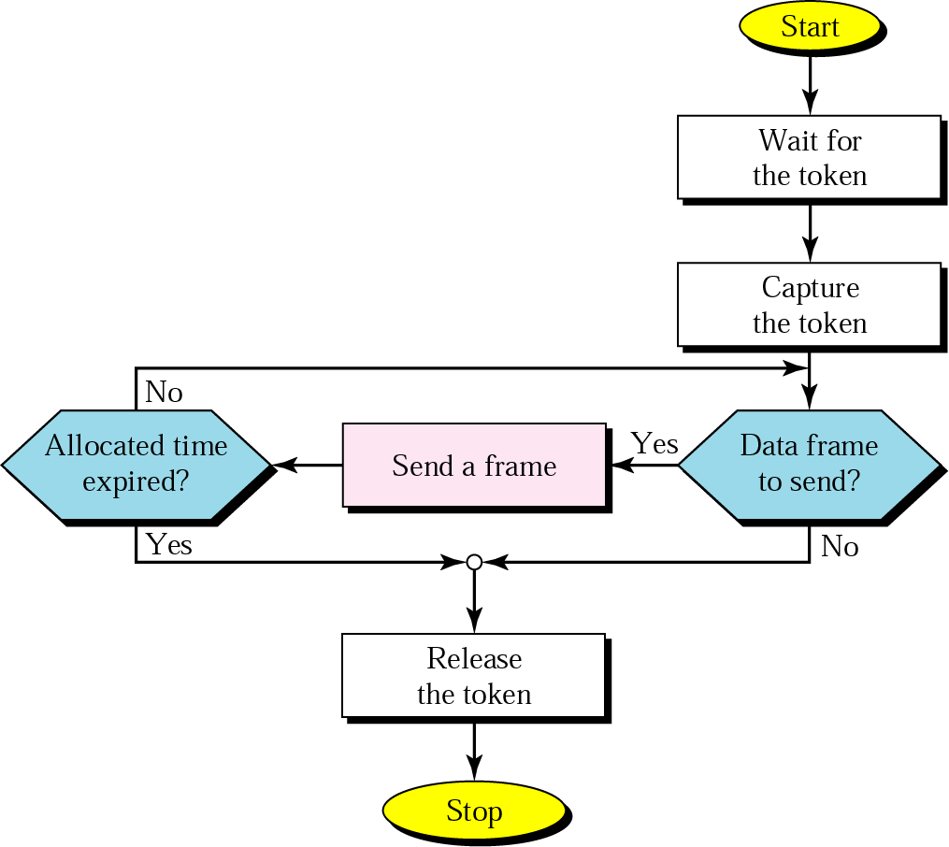
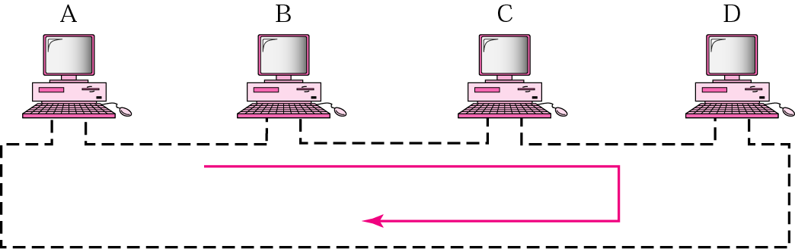

Slide 19
token failures: tokens can be created or destroyed by noise
distributed solution
nodes are allowed to recognize the loss of a token and create a new token
collision occurs when two or more nodes create a new token at the same time => need collision resolution algorithms
node failures: since each node must relay all incoming data, the failure of a single node will disrupt the operation of the ring

Slide 20
Ethernet
Traditional Ethernet (IEEE 802.3)
the most popular LAN physical network architecture in use today
originally created in 1976 at Xerox’s Palo Alta Research Center (not a commercial success for itself) to operate at 10 Mbps
usually called traditional Ethernet.
uses 1-persistent CSMA/CD
an Ethernet frame contains 7 fields

Slide 21
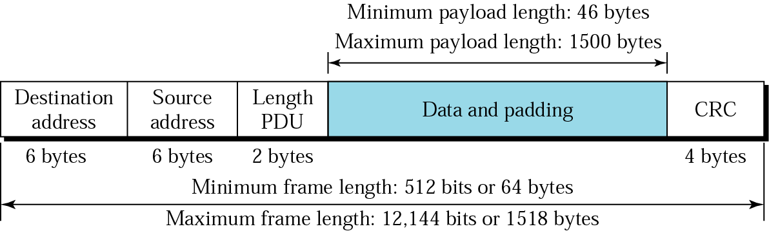
PDU - Protocol Data Unit
minimum and maximum frame lengths are defined without the preamble and the SFD.
padding is used if the packet size is less than the minimum packet size.

Slide 22

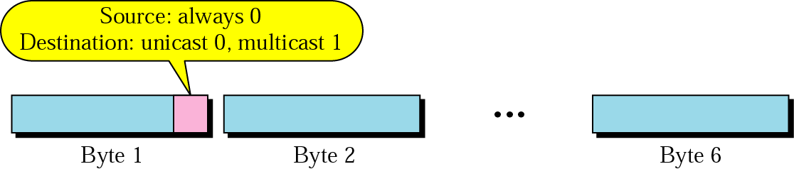
Addressing
a NIC provides a 6-byte physical address or MAC (Media Access Control address) in hexadecimal;
there are 2⁴⁸ possible LAN addresses;
a NIC’s address is permanent - a LAN address is burned into its ROM during manufacturing
Unicast, Multicast, and Broadcast addresses:
a source address is always a unicast address;
the destination address can be unicast (only one destination), multicast (multiple destinations), or broadcast (all the stations on the network - 48 1s)

Slide 23
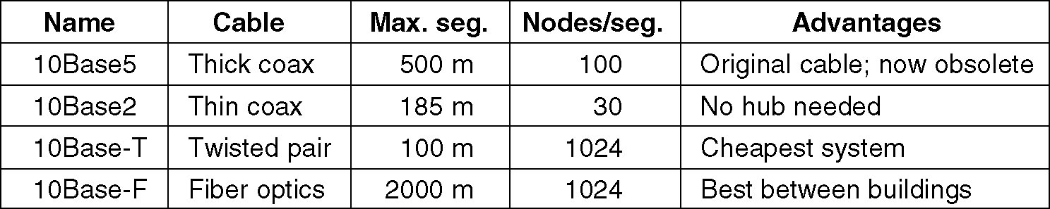
four most common kinds of 10 Mbps Ethernet cabling
Where
10 - 10 Mbps
Base - Baseband (against broadband with more bandwidth than standard telephone service)
5 (2) - maximum segment length; rounded to units of 100 meters (for coax)
T - Twisted Pair, F - Fiber

Slide 24
a hub is used in 10Base-T and 10Base-F to which each station is connected by a dedicated cable.
10Base5 is also called Thick Ethernet and 10Base2 is Thin Ethernet
10Base5 and 10Base2 use bus topology;
10Base-T and 10Base-F use star topology
Segmentation (of a network not a frame)
performance depends on the number of stations.
the more stations we have the less will be the performance.
when a lot of stations have data to transmit, the network gets congested, and many collisions occur
in a network with severe congestion, there may actually be more collisions occurring on the network than data being transmitted

Slide 25
Solution: Segmentation
the process of splitting a large Ethernet network into two or more segments linked by routers
the resulting segments have fewer stations to contend with for access to the network
the router transfers data from one segment to the other only when the destination for the data is on the other segment
the rest of the network traffic stays within the segment where it belongs

Slide 26
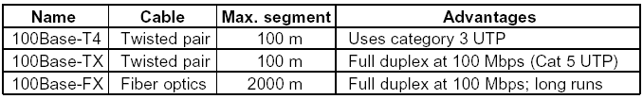
Fast Ethernet (IEEE 802.3u)
the need for a higher data rate resulted in the design of the Fast Ethernet protocol (100 Mbps)
basic idea: keep all the old frame formats, interfaces, and procedural rules, but reduce the bit time from 100 ns (10 Mbps) to 10 ns (100 Mbps)
a new feature, called auto-negotiation, is added to allow
incompatible devices to communicate with one another,
e.g. one with 10 Mbps and one with 100 Mbps - backward compatibility)
one device to have multiple capabilities
a station to check a hub’s capabilities
the three most common kinds of Fast Ethernet cabling

Slide 27
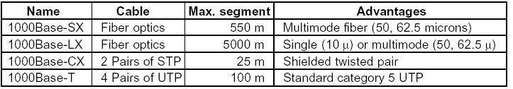
Gigabit Ethernet (IEEE 802.3z)
recent need for an even higher data rate resulted in the design of the Gigabit Ethernet protocol (1000 Mbps)
basic idea: make Ethernet go 10 times faster yet remain backward compatible with all existing Ethernet standards
the four most common kinds of Gigabit Ethernet cabling

Slide 28
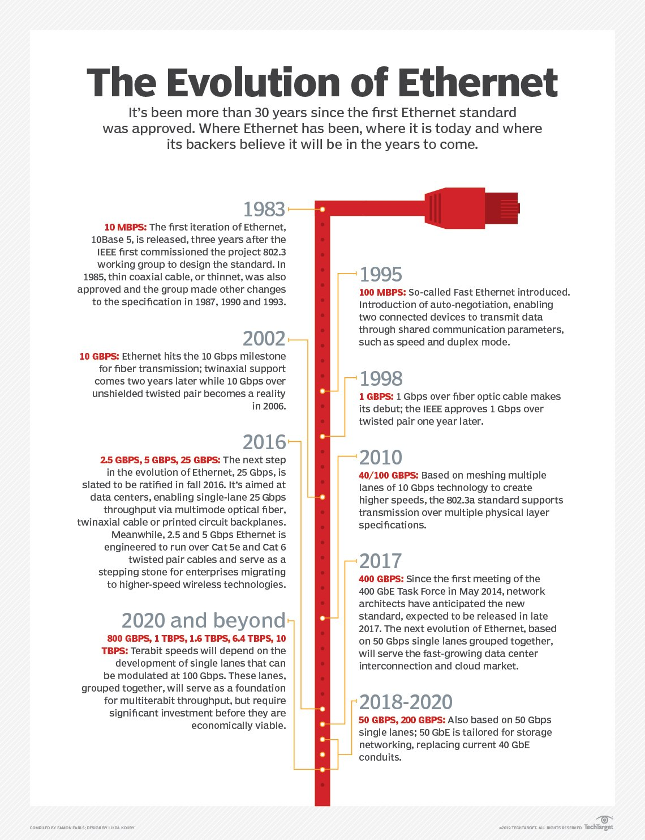

Slide 29
Token Bus (IEEE 802.4)
proposed by General Motors
the stations on the bus form a logical ring,
i.e., the stations are assigned logical positions in an ordered sequence, with the last member followed by the first
the physical ordering of the stations on the bus is irrelevant and independent of the logical ordering;
it has ring logical topology and bus physical topology
it uses token passing medium access control protocol

Slide 30
10
20
30
40
50
60
in the example, stations 60, 50, 30, and 10, in that order, are part of the logical ring
station 60 passes the token to 50, which in turn passes it to 30, then to 10, then back to 60;
stations 20 and 40 are not part of the logical ring
each participating station knows the address of its predecessor and successor
the logical ring is created and maintained dynamically in such a way that the stations are logically ordered in numerically descending order of MAC address, except that the station with the lowest address is followed by the station with the highest address

Slide 31
the token bus system requires considerable maintenance;
one or more stations must perform the following functions, at minimum:
addition to the ring:
periodically non-participating stations must be granted the opportunity to join the logical ring
deletion from the ring:
a station can remove itself from the logical ring
ring initialization:
when the network is started, some procedure is needed to sort out who goes first, who goes second, and so on
token recovery:
if the token is lost due to a transmission error or station failure, some means of recovery is needed
nobody uses it ☺

Slide 32
Token Ring (IEEE 802.5)
introduced by IBM in early 1980’s
has ring logical topology;
the physical topology can be ring or star
it uses token passing medium access control protocol
Only a host that holds a token can send data, and tokens are released when receipt of the data is confirmed.
Token ring networks prevent data packets from colliding on a network segment.
The IEEE standard version provides for data transfer rates of 4, 16 or 100 Mbps.

Slide 33
Token ring was once widely used on LANs, but has been nearly entirely displaced by Ethernet thanks to pricing.
token ring products tended to be more expensive than Ethernet at similar speeds
still in use at some IBM sites; but virtually nowhere else

Slide 34
Ethernet Vs. Token Ring
Ethernet | Token Ring
Access is non-deterministic (contention-based CSMA/CD) | Access is deterministic
Supports a direct-cable connection between two NICs | Doesn’t support direct cable connection. Requires additional software and hardware
Alleviates collision by CSMA and by the use of an intelligent switch | Eliminates collision by the use of a single-use token and early token release to alleviate the down time
Less expensive | More expensive

Slide 35
References
https://searchnetworking.techtarget.com/definition/Token-Ring
https://searchnetworking.techtarget.com/definition/Ethernet
https://en.wikipedia.org/wiki/Token_ring

